Slide 1
Data Analytics and Visualization On Avian Disease
Course : PRT564
Presented By- Group G6(Sydney)
Members | Student ID
ABRAR YASIR | S379181
MEHRUZ SAIF | S383768
DEBRAJ RAKSHIT | S382665
SYED RUBAYAT HOSSAIN | S383306

Slide 2
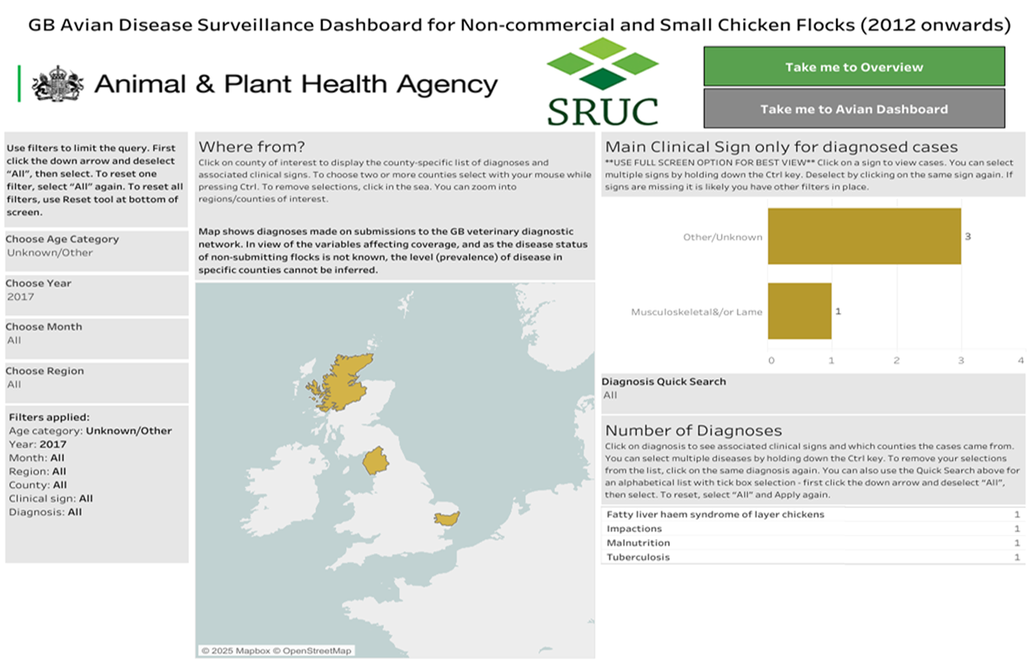
Avian Dashboard Interface & Manual Data Collection
Data collected manually from UK Animal & Plant Health Agency's Tableau dashboard.

Slide 3
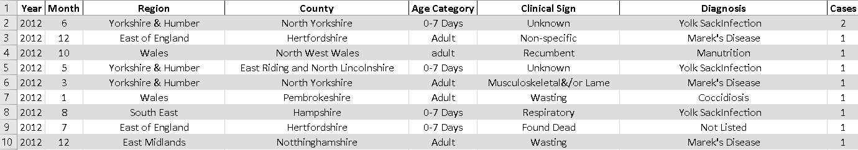
Dataset Creation and Preprocessing
Dataset Description: Dataset includes the following information:
Year and Month of the outbreak.
Region and County where the outbreak occurred.
Age Category of the affected birds.
Clinical Signs observed.
Diagnosis of the disease.
Number of Cases reported.

Slide 4
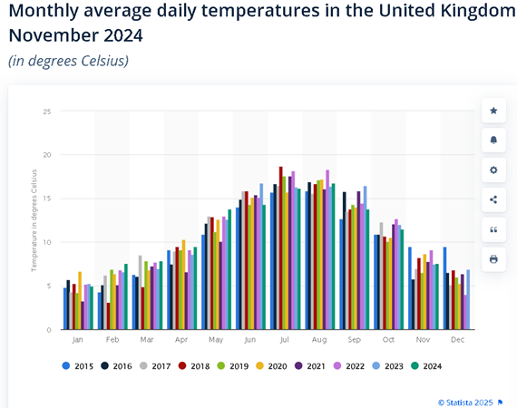
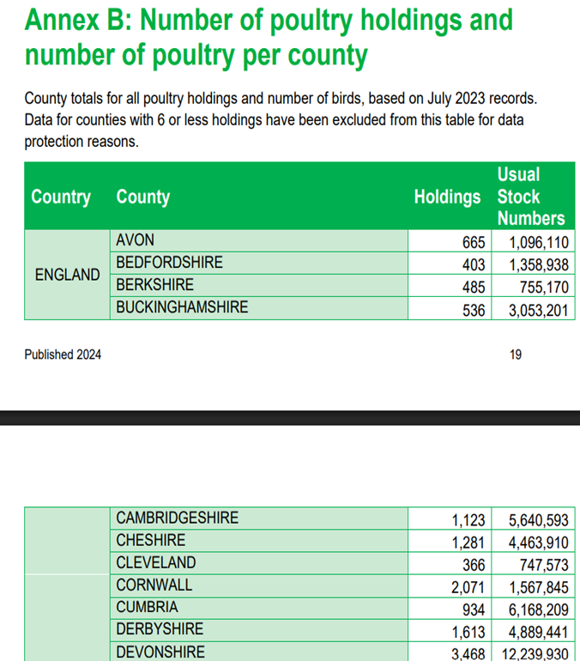
Supplementary Data Integration (Temperature & Poultry Density)
UK Monthly Temperatures obtained from Met Office and Statista summaries.
Poultry Density information retrieved from DEFRA livestock report.
These additions enhanced heterogeneity and realism of dataset.

Slide 5
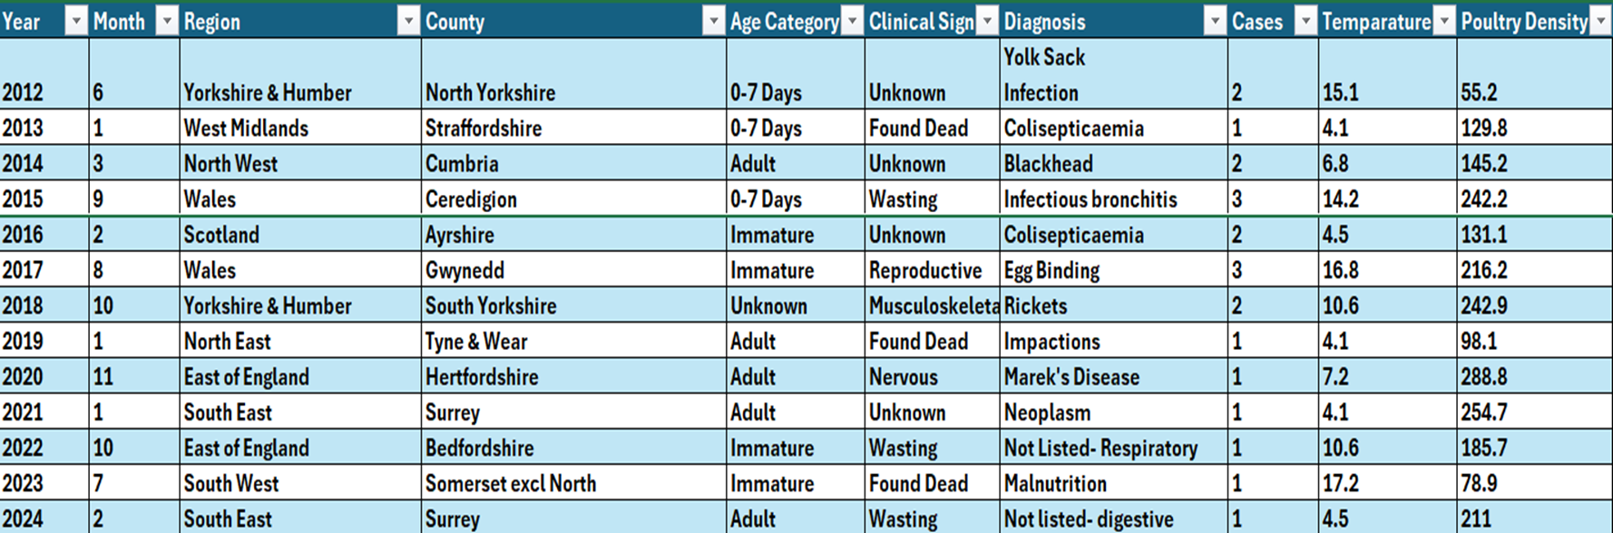
Raw Dataset and Sampling Strategy
Initially we manually added 400+ rows.
Final dataset: 142 rows with wide variation across years and case counts.
Around 11 rows per year were selected for avoiding year-dominance and supporting equal visual representation.
Rows with more than one case prioritized for diversity.
Smaller dataset supports clear visual storytelling.

Slide 6
Exploratory Data Analysis
On Avian Disease

Slide 7
Dataset Overview
Total Data: 142
Goals: Identify factors associated with poultry disease outbreaks.

Slide 8
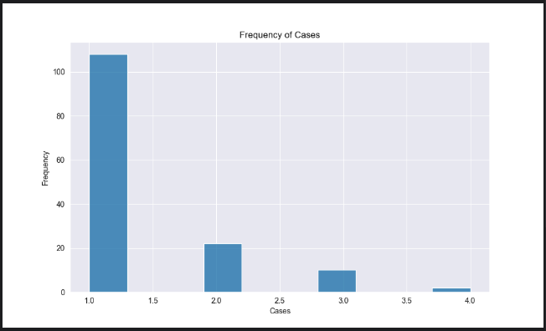
Histogram of Cases
Case Frequency Distribution
Most Records have 1-2 cases.
Few high cases.

Slide 9
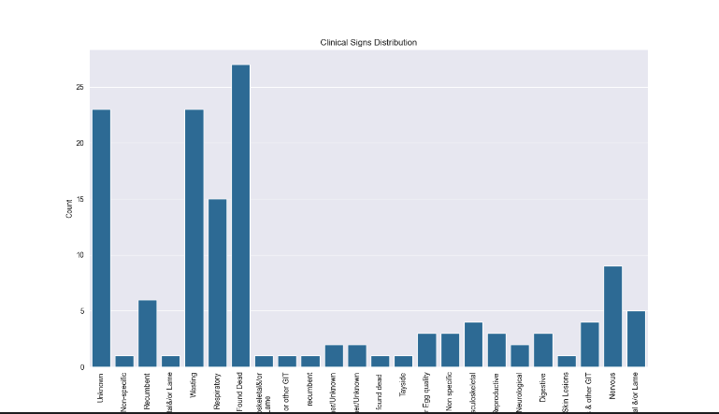
Countplot of Clinical Signs
Clinical signs Distribution

Slide 10
Clinical Signs Distribution
Most frequent signs: Respiratory, Found Dead
Commonly observed Symptoms

Slide 11
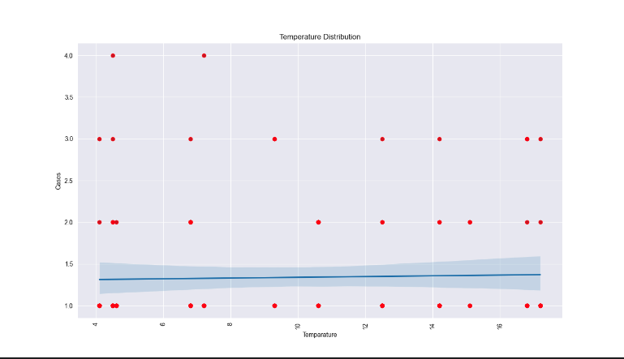
Scatterplot: Temperature vs Cases

Slide 12
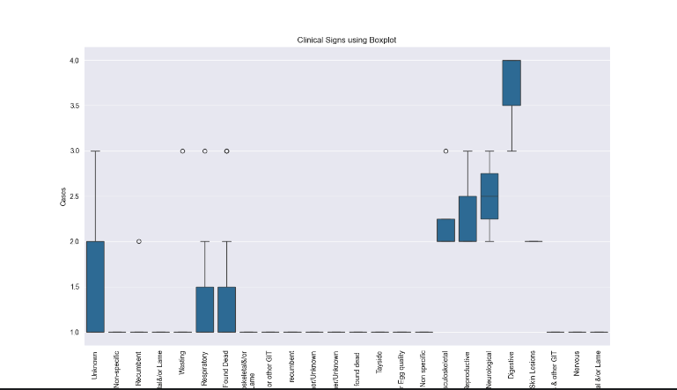
Boxplot (Clinical Sign vs Cases)
Outliers for “Found Dead” category.
Helps identify which signs are linked To high case counts.

Slide 13
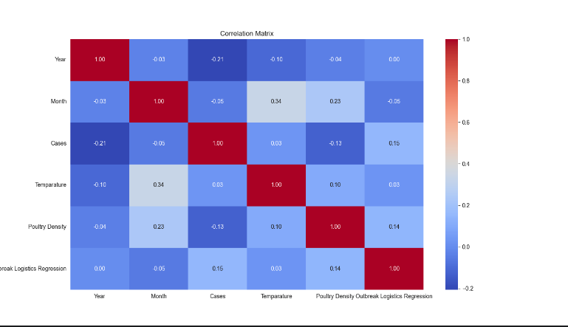
Heatmap: Correlation Matrix

Slide 14
Heatmap
Moderate correlation between temperature, poultry density, and outbreak probability
Justifies their use in modelling

Slide 15
Insights
EDA showed low-to-moderate relationships between outbreak likelihood and environmental factors
Temperature and poultry density selected for modelling
Barplot, Lineplot
Next step: Build and evaluate regression model

Slide 16
Implementation of Regression Model
Linear and Logistic Regression Analysis on Avian Dataset
Split the data:
80% for training
20% for testing correlated data with less variance were selected for better outcomes.

Slide 17
Justifications for Chosen Models
Linear Regression:
Purpose: Predicts a continuous dependent variable using features like Temperature, Poultry Density.
Justification: Appropriate since 'Outbreak Logistics Regression' is continuous.
Logistic Regression:
Purpose: Predicts binary outcomes (e.g., outbreak vs. no outbreak).
Justification: Ideal for 'Cases' variable transformed into binary (0 = No Outbreak, 1 = Outbreak).
TOTAL OBSERVATIONS | 150
CASES =1 | 122
CASES=2 | 22
CASES>2 | 6
Most observations are 1 case, with rare occurrences of more than 1 case

Slide 18
Linear Regression Implementation
Target Variable: Outbreak Logistics Regression
Features: Temperature, Poultry Density
Steps:
Fit the linear regression model.
Interpret the results.
Mean Squared Error (Linear Regression): 0.049478748058440665

Slide 19
Logistic Regression Implementation
Target Variable: Binary Cases (0 = No Outbreak, 1 = Outbreak)
Features: Temperature, Poultry Density, Clinical Sign
Steps:
Convert 'Cases' to binary.
Fit the logistic regression model.
Remarks | Outcome
if Cases > 1 | Outbreak
else 0 | No Outbreak
Accuracy of Logistic Regression: 0.6551724137931034

Slide 20
Model Evaluation
Linear Regression:
Mean Squared Error (MSE): 0.0471
Indicates low prediction error.
Logistic Regression:
Accuracy: 76.71%
Effectively classifies outbreak occurrences.

Slide 21
Why Logistic Regression for Avian Disease Data?
To predict the probability of an avian disease outbreak (Yes/No) by the help of binary outcomes.
To identify factors (e.g., temperature, poultry density, region) that increase or decrease the risk of an outbreak.
Provides coefficients that indicate the direction and strength of the relationship between each factor and the outbreak risk.

Slide 22
Why Not Linear Regression?
Linear regression treats all values of the outcome variable equally, but in our case, predicting 'Found Dead' (a rare but important event) might require a different approach.

Slide 23
Statistical Test Results
Following results from the analysis are obtained ;
t-statistic: -5.025 p-value: 3.54 × 10⁻⁶
Since the p-value is much smaller than the typical significance level of 0.05, we can reject the null hypothesis and conclude that there is a statistically significant difference between the performance of the Linear Regression and Logistic Regression models.

Slide 24
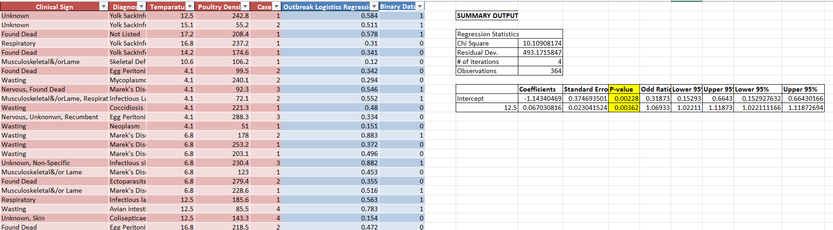
Statistical Test Results
P-Value less than significant value(0.005)
Regression Statistics Data in Excel:
To confirm further performed regression analysis with the help of MS Excel descriptive analytical tools and found the following result;

Slide 25
Differences in Two models based on Result
Based on the test, we can conclude that [Conclusion about which model performed better and if the difference is statistically significant].
SO, differences in two models can be stated as below;
Linear Regression | Logistic Regression
The model suggests that temperature and density alone might not fully explain the outbreaks, meaning there are likely other factors to consider. | This model achieved good accuracy and can be used to help decision-makers identify regions at risk for outbreaks, enabling proactive measures like vaccination or quarantine.

Slide 26
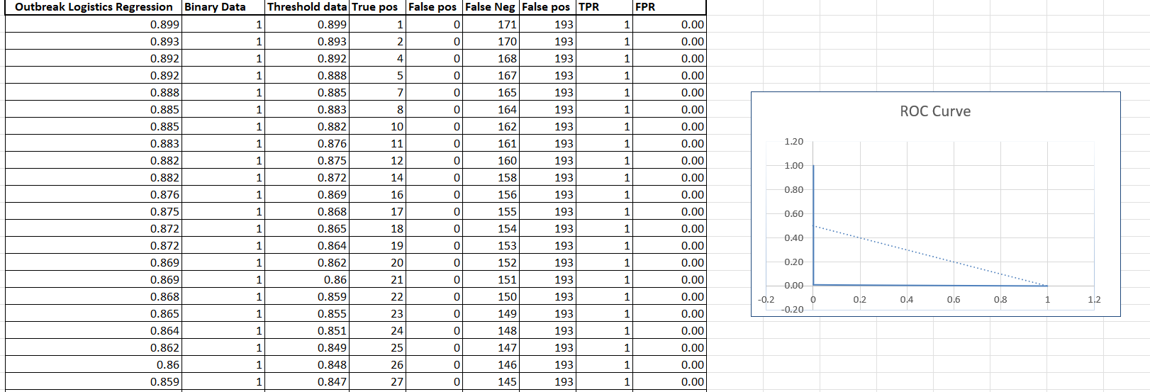
Measuring the ROC Curve and Regression Justification
ROC (Receiver Operating Characteristic) curve visually summarizes the performance of our logistic regression model across various classification thresholds.
Visualization of ROC Curve:

Slide 27
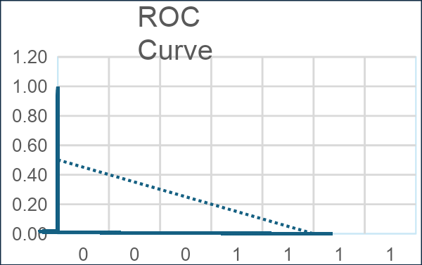
Measuring the ROC Curve and Regression Justification
Observations from ROC Curve Trend Line:
Y Axis= TPR(Total Pos Rate) X Axis= FPR(False Pos Rate)
On the y-axis, we see the TPR. The solid blue line starts at a TPR of 1.00 when the False Positive Rate is 0.00. This indicates that at this threshold, all actual positive cases were correctly identified. As the False Positive Rate increases, the True Positive Rate decreases.
Specifically, the initial steep rise on the left suggests that the model can achieve a relatively good TPR with a low FPR at certain thresholds. As we move along the curve to the right, aiming for an even higher TPR comes at the cost of a proportionally larger increase in the FPR.

Slide 28
Future Aspects of Our Analysis
To Utilize environmental surveillance methods, including wastewater testing on farms.
Evaluate and enhance current biosecurity measures and vaccination programs to mitigate the spread of highly pathogenic avian influenza viruses, considering the economic and public health implications.
Develop an immuno-epidemiological framework that considers the interplay between avian influenza infections in birds, humans, and other animals to predict pandemic conditions and inform control strategies.

Slide 29
AI Contribution Declaration
We used AI tools like ChatGPT, Deepseek and simple google search results to refine our research direction and develop the project structure.
AI helped us analyze patterns in data and choose appropriate regression models.
Visuals like scatterplots and heatmaps were inspired or reviewed with AI support.
Drafting parts of the report and summarizing results was done with AI assistance.
All final analysis and decisions were critically reviewed and implemented by us.
AI was a support tool, not the decision-maker — ensuring academic integrity

Slide 30
Thank You

